Slide 1


Can Other Laboratory Test Provide Hints of Covid19 Positive Results?
Carla Harrell

Slide 2
COVID-19 is a newly discovered infectious disease that can cause mild to severe respiratory illness. It appears those with underlying conditions such as diabetes, hypertension, cardiovascular disease, and other serious illness are more at risk. COVID-19 is an RNA virus which belongs to the family coronavirus and was initially emerged in China around December 2019. The wide spread of this virus has become a pandemic. The COVID-19 pandemic have many scrambling all over the world trying to contain the spread of the virus. Many people were requested to stay at home if they do not have severe symptoms while others are walking around asymptomatic who can possibly spread the virus. Since the start there were numerous difficulties, for example, the absence of testing which includes testing facilities , testing materials, faulty testing material, reporting mechanism, and more.

Slide 3

Project Goal
The objective of this project is to attempt to connect other laboratory test that can provide patients with speedier results and conceivably stop the spread until diagnostic analytic testing is available.

Slide 4
Data
This dataset contains anonymized data from patients seen at the Hospital Israelita Albert Einstein, at São Paulo, Brazil, and who had samples collected to perform the SARS-CoV-2 RT-PCR and additional laboratory tests during a visit to the hospital. All data were anonymized following the best international practices and recommendations. The clinical data were standardized to have a mean of zero and a unit standard deviation.
This data consists of 5644 patients and 109 different diagnostic attributes. The target variable which states whether that patient is Covid positive or Covid negative. In other words, the goal is to predict whether the patient is Covid positive or Covid negative using the 109 variables through the application of Data Science.
https://www.kaggle.com/ingoraum/laboratory-data-to-detect-covid-19-and-risk-groups

Slide 5
References:
https://www.kaggle.com/tanuprabhu/population-by-country-2020
https://aruljohn.com/usstates/
https://worldpopulationreview.com/states/median-age-by-state/
https://www.worldometers.info/world-population/us-population/
https://www.kaggle.com/sudalairajkumar/covid19-in-usa
https://www.kaggle.com/sudalairajkumar/covid19-in-usa
https://github.com/CSSEGISandData/COVID-19/tree/master/csse_covid_19_data/csse_covid_19_time_series
Thomas, Liji (June 2020). Monocytes could be critical in dysregulated immunity in Covid-19 patients. https://www.news-medical.net/news/20200608/Monocytes-could-be-critical-in-dysregulated-immunity-in-COVID-19.aspx
UC Davis Health (March 2020.) What blood test of COVID-19 patient can tell us. https://health.ucdavis.edu/health-news/newsroom/what-the-blood-tests-of-a-covid-19-patient-can-tell-us/2020/03
Wang, L (March2020). C-reactive protein levels in the early stage of COVID-19.

Slide 6
Methods
Exploratory Data Analysis
Dropping junk variables
Correlation matrix
Handle missing values in the remaining variables.
Train and Validation
Plot decision tree on training and validation split
Feature Importance's
Bivariate analysis of Top features

Slide 7
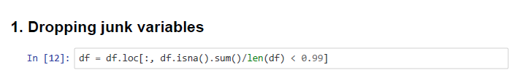
Dropping of Junk Variables
The above code drops the variables which has greater than 99% of missing values.

Slide 8
Correlation Matrix
This will help us understand the correlation among the variables and give an idea of variables which are highly correlated and whether there exists multi-collinearity among the variables.

Slide 9
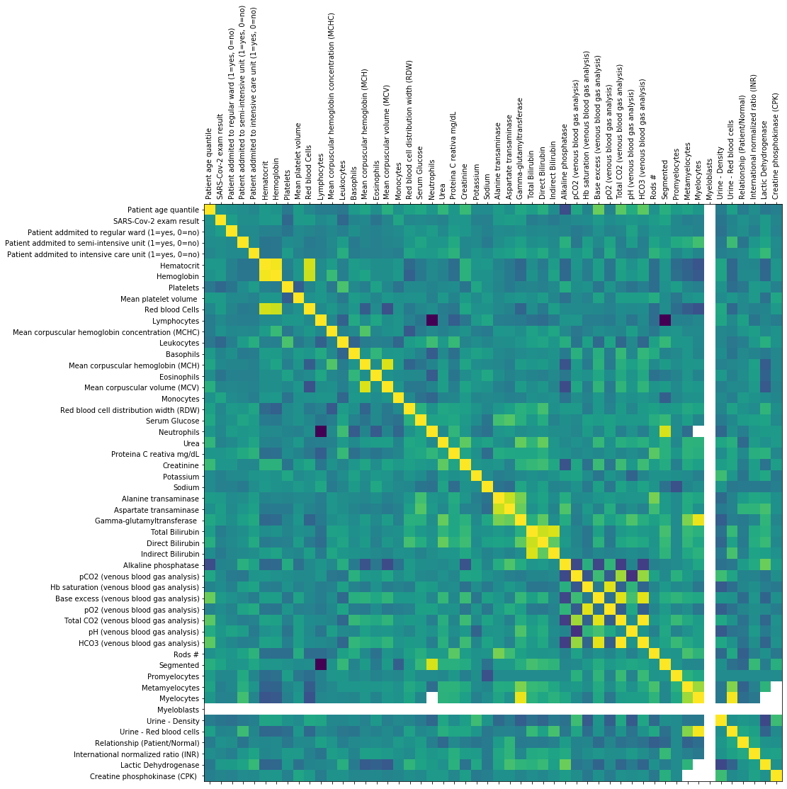

Slide 10
Handling of Missing Value in the Remaining Variables.
Some of the variables in the dataset contained missing values. Since the values cannot directly be replaced with 0, for instance a missing Hemoglobin doesn't really mean 0 Hemoglobin, this missing value could hold some data that the physician didn't counsel the patient for doing the Hemoglobin check for reasons unknown. We do not want to miss this information and hence replace it with 999 so that these are understood as missing. Those values would be applied in the decision tree. So, a missing value which would be 999 would be treated as a different bucket. This would prevent information from being lost.

Slide 11
Training and Validation Split
Before the data is spit into training and validation, the dtype of the variables were checked.
The categorical object dtype variables will be converted into dummies and then a decision tree would fit over it.
Variables whose number of categories are less than 10 will be included.
The data was split into training and validation with 70:30 ratio which helps to visualize the overfitting or underfitting issue.

Slide 12
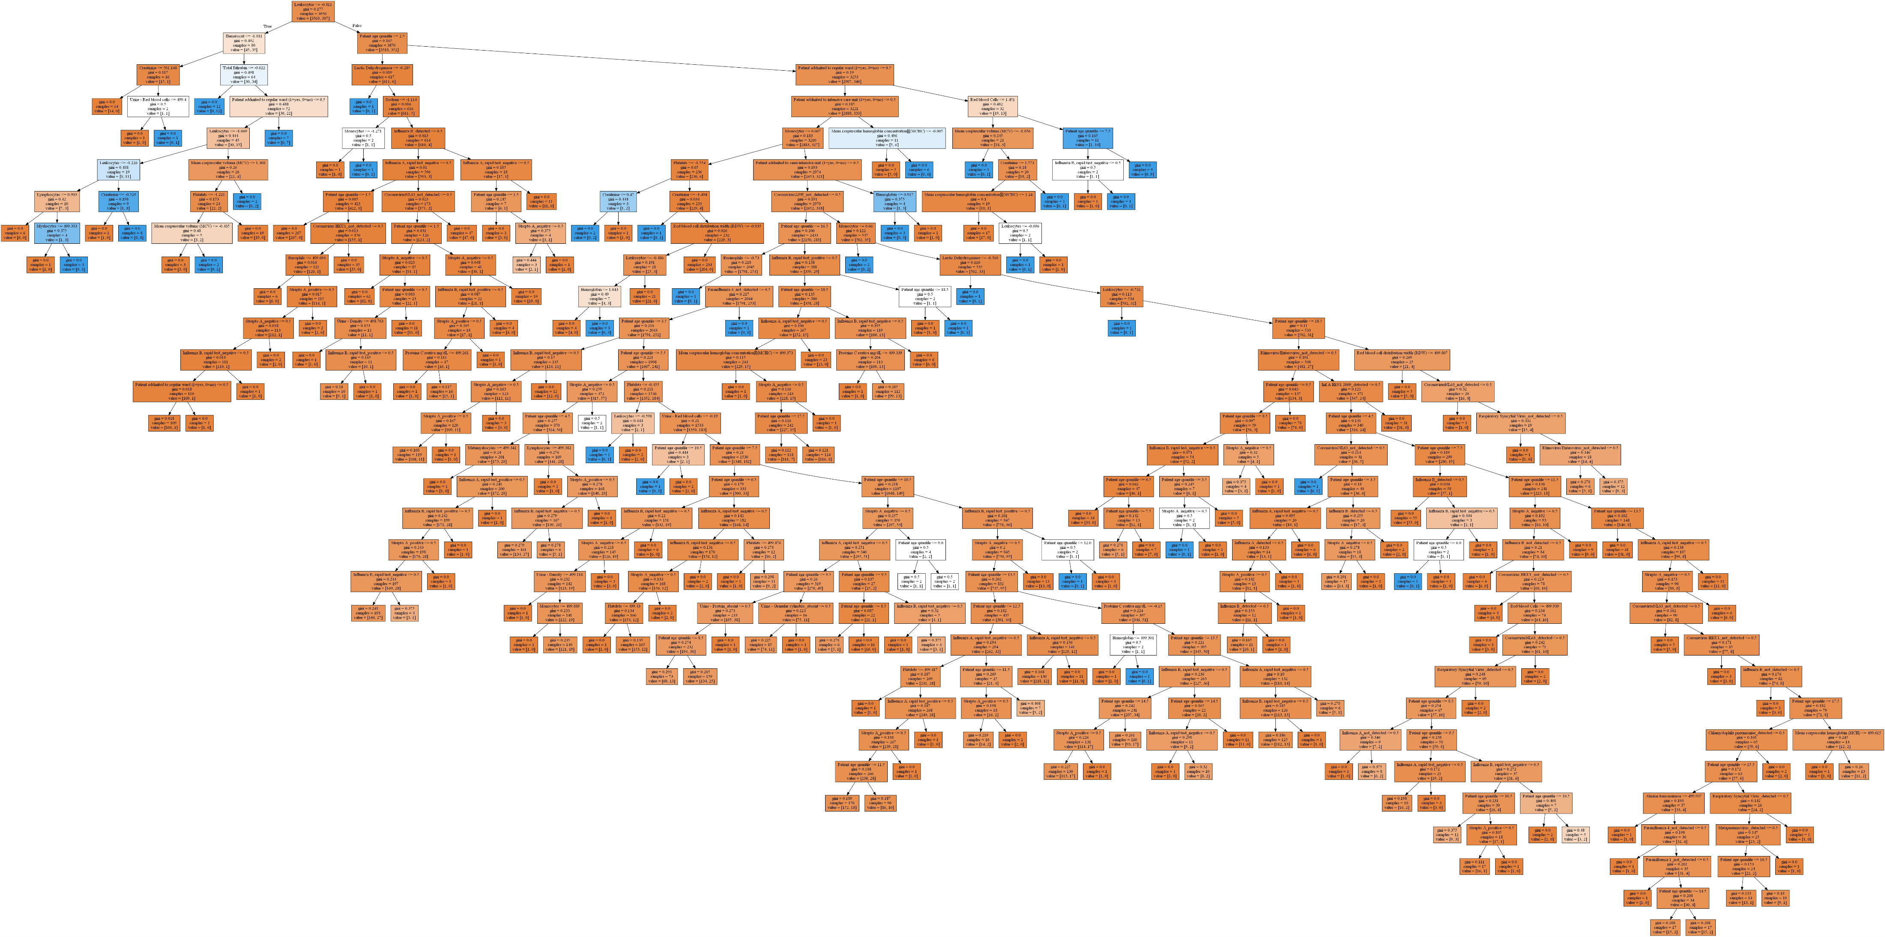
A Decision Trees was drawn to look at the data, but there is an abundance of data.

Slide 13
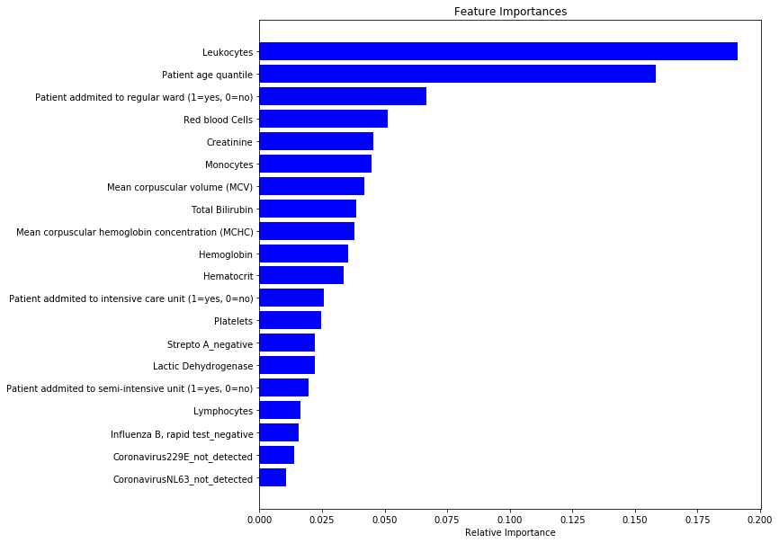
Feature Importance
In order to understand the variables, a plot was drawn based upon the top 20 variables that has high predicative power in predicting Covid +ve or Covid -ve .

Slide 14
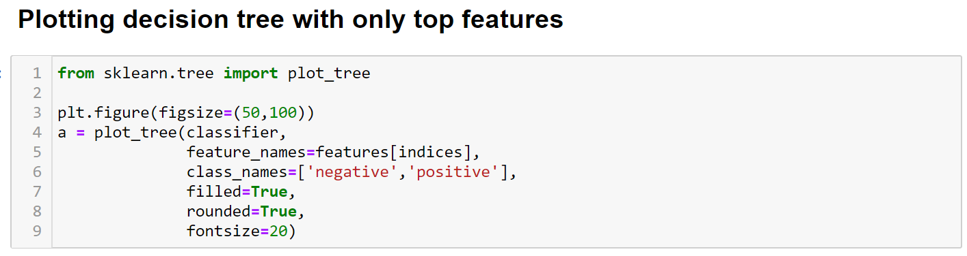
Since the original decision tree model contained a lot of data, the model will be refitted using the top features.

Slide 15
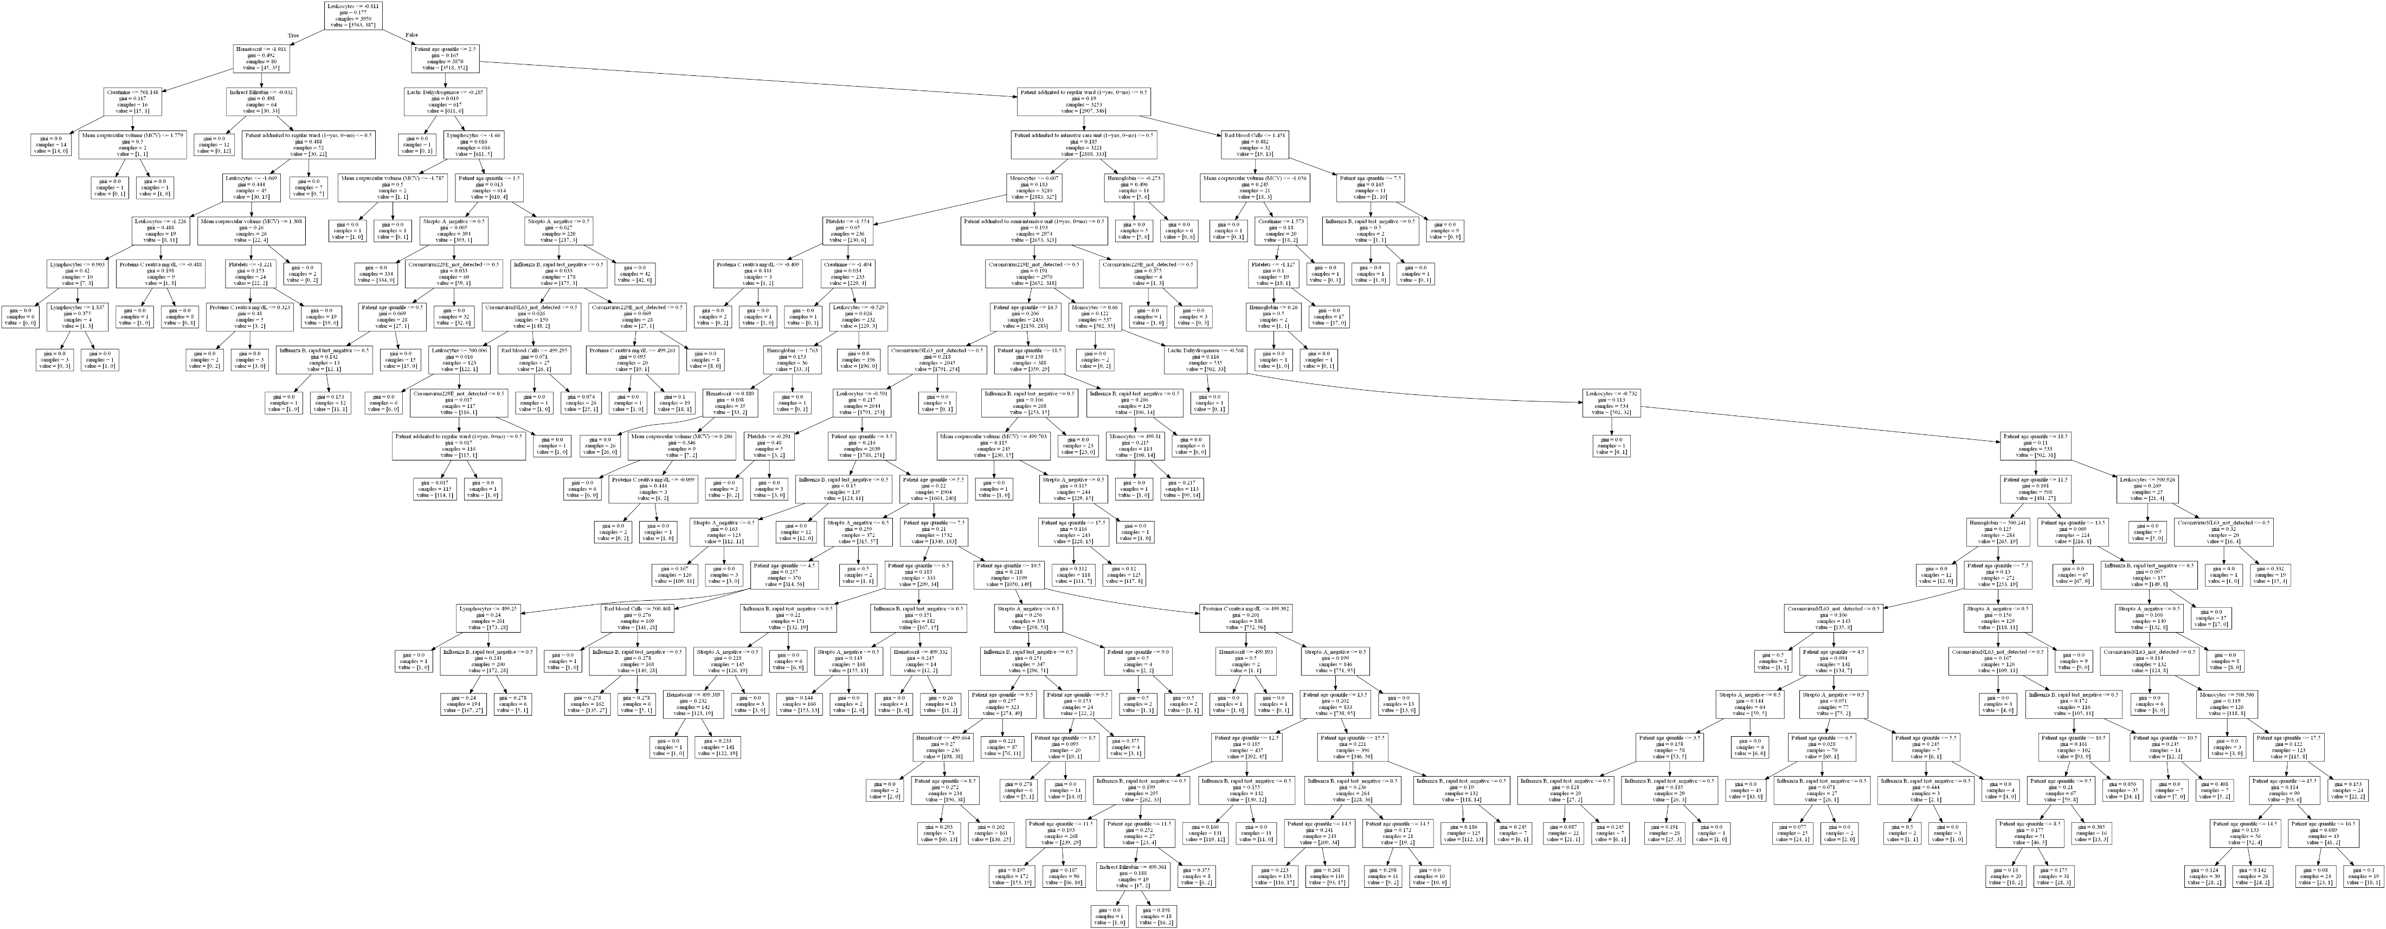

Slide 16
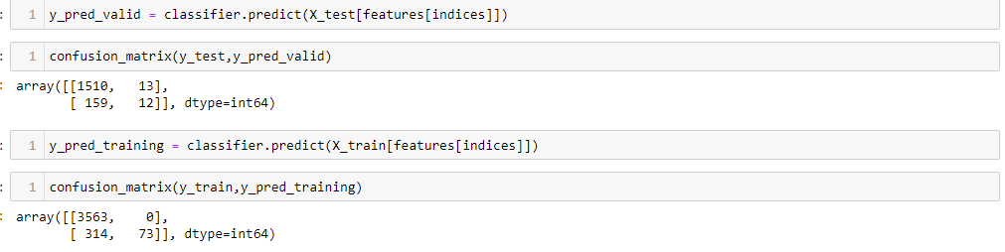
Confusion Matrices Of Training And Validation
Training dataset: Out of 387 positives in validation, we predicted 313 of them as negative for a 0.5 cut off in probability which is not recommended. However, by lowering the cutoff of probability to divide between 0 and 1 would help in getting better predictions.
Validation dataset: Out of 171 positives in validation, we predicted 158 of them as negative which is not recommended. However, by lowering the cutoff of probability to divide between 0 and 1 would make things better.

Slide 17

Bivariate Analysis of Top Features

Slide 18
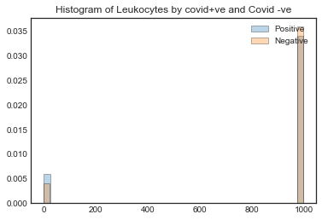
Bivariate Analysis of Top Features

Slide 19
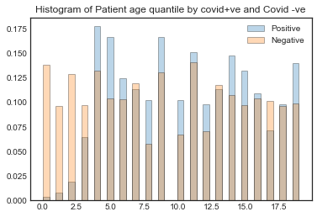
Bivariate Analysis of Top Features

Slide 20
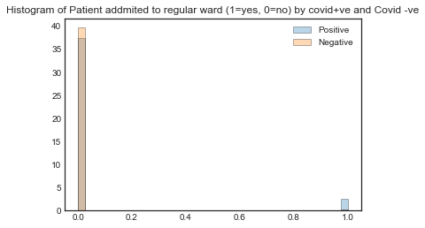
Bivariate Analysis of Top Features

Slide 21

Bivariate Analysis of Top Features

Slide 22

Bivariate Analysis of Top Features

Slide 23
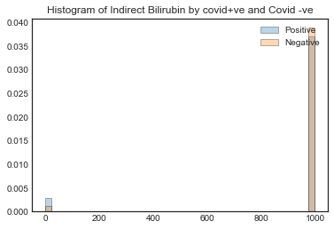
Bivariate Analysis of Top Features

Slide 24

Bivariate Analysis of Top Features

Slide 25
Discussion
The accuracy of this datasets may not be reliable especially with the method normalization of the data. In clinical laboratory settings, normal ranges are established for each test. The values are based upon the patient population. As far as normalization goes, each clinical setting can be normalized based upon the patient population which will provide the clinicians with pertinent information. In this dataset some laboratory values were left off such as procalcitonin which is used to rule out if a patient has a bacterial or viral infection. Since Covid is viral, this test can be very useful. Data is generated at medical facilities and a decision tree model could potentially be an early indicator used by licensed medical physicians to make the decisions for treatments. Early detection can lead to early treatments which also decrease the spread by quarantine methods. In healthcare, it is very critical to have a team with medical professional such as medical doctors to accurately select the right variables when building models. The sole purpose of this model is help stop the spread and provide answers to the unknown as the world continue to learn about this virus that is causing havoc around the world.

